Slide 1
INVENTORY MANAGEMENT : DRINK & DELIGHT
Astha
Sagar Sharma
Tanisha Singh
Pulak Sinha
Shivam Tewari
GROUP - C

Slide 2
Epic & user stories
Epic1 : Supplier Payment Management in D&D
User Stories :
Collecting Order Credentials from System User and then checking for Payment status.
If the payment is successful then an Order ID is generated and then the “Order Placed” status is changed to “Order Confirmed”.
The payment credentials to these suppliers are then stored in a database containing Supplier information.
If the payment fails, whatever may be the reason, then the System user asks for fresh payment of the order if needed.

Slide 3
Epic & user stories (contd.)
Epic2 : Distributor Payment Management in D&D
User Stories :
Collecting Order Credentials from System User and then checking for Payment status.
If the payment is successful then an Order ID is generated and then the “Order dispatch” status is changed to “Order Confirmed”.
The payment credentials from these distributors are then stored in a database containing Distributor information.
If the payment fails, whatever may be the reason, then the System user asks for fresh payment of the order if needed.

Slide 4
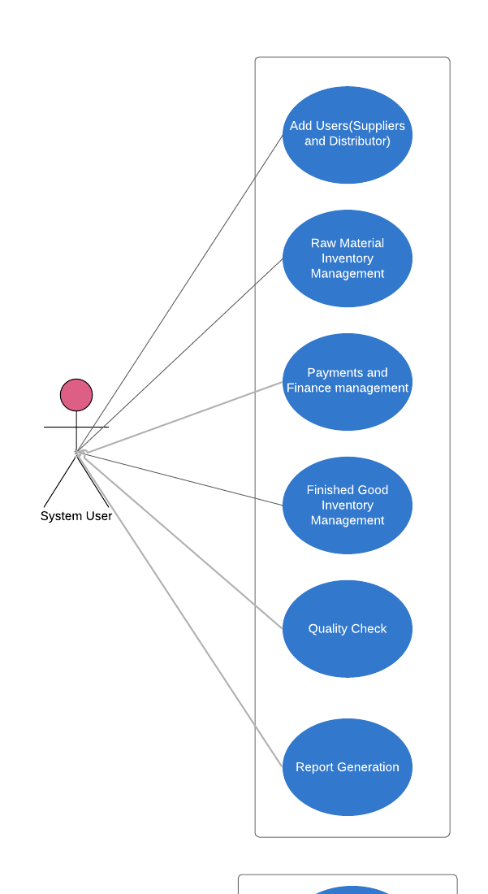
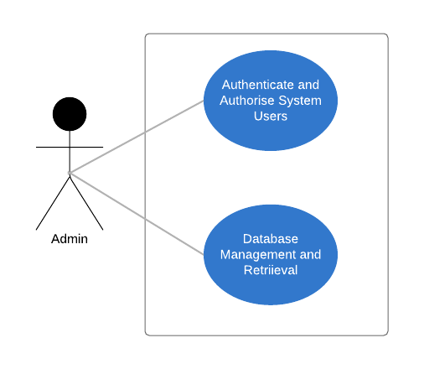
Use Case Diagram

Slide 5
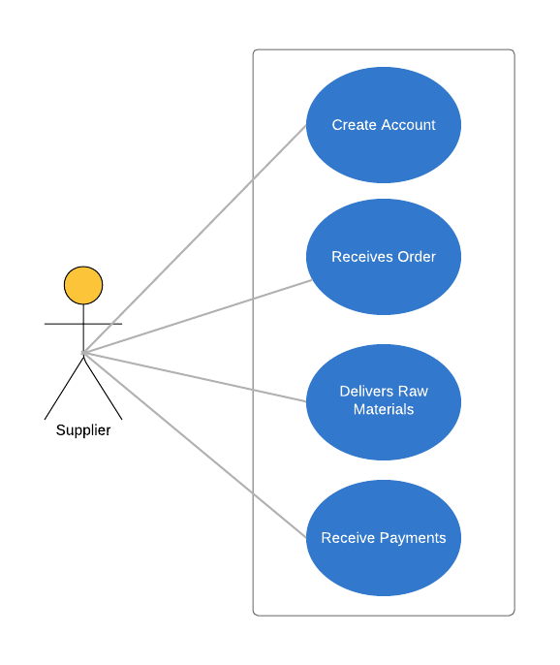
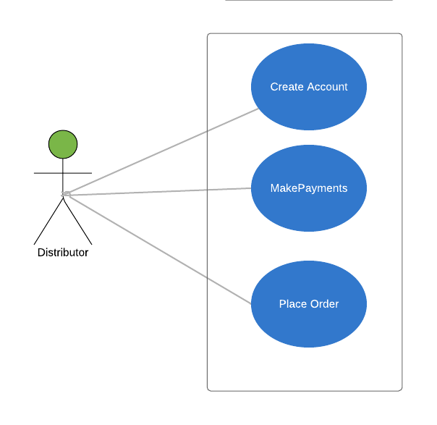
Use Case Diagram

Slide 6
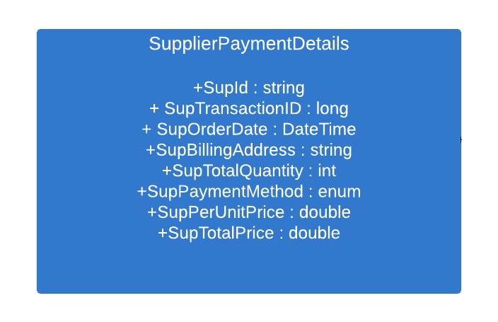
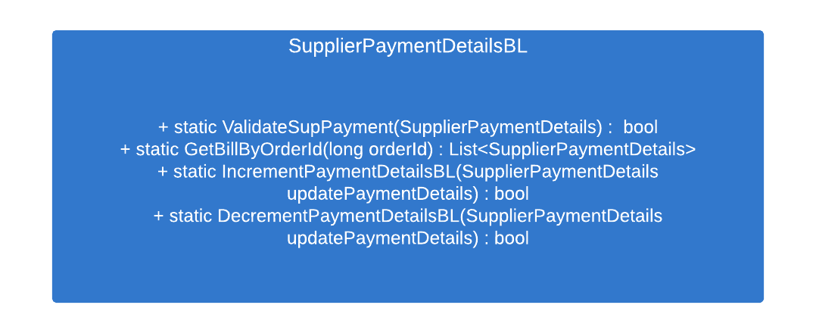
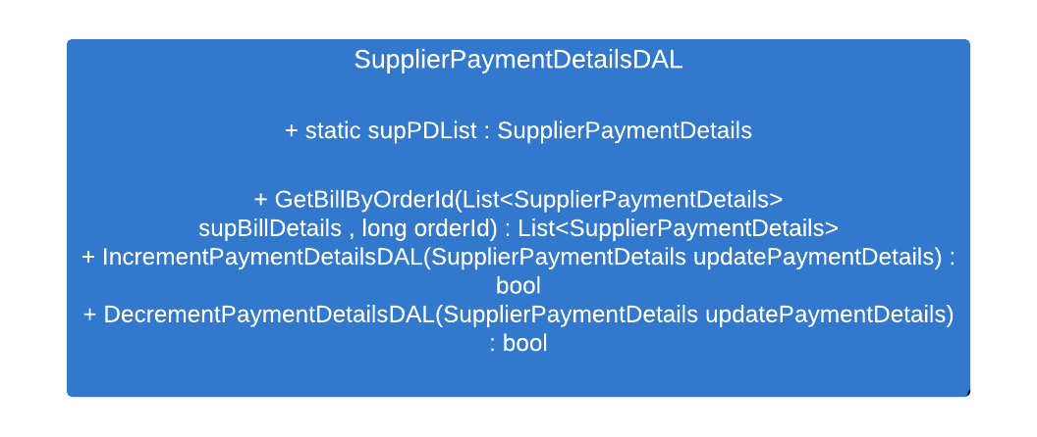
Class Diagram for Supplier Payment Details

Slide 7
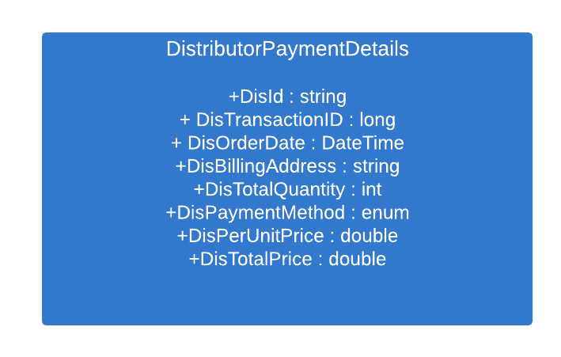
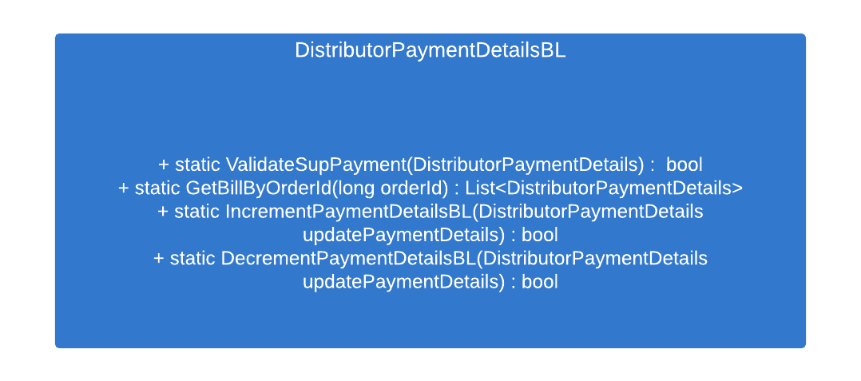
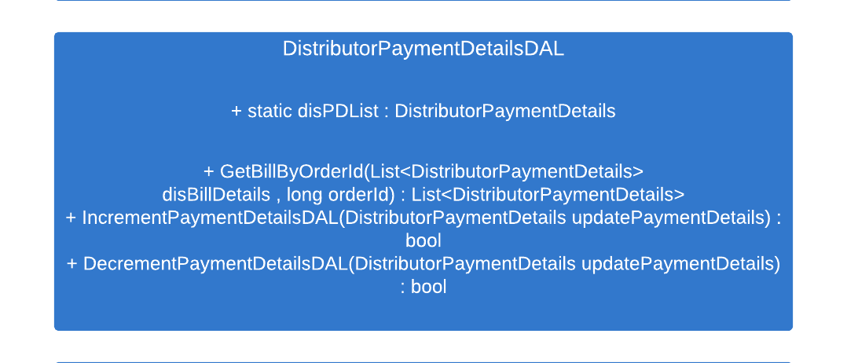
Class Diagram for Distributor Payment Details

Slide 8
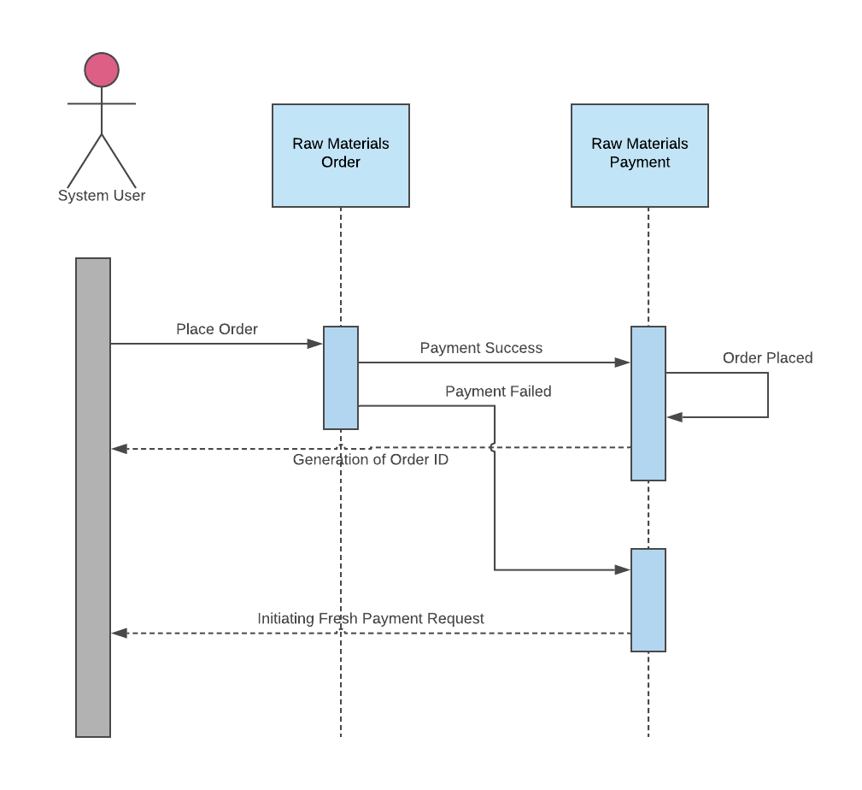
Sequence Diagram :
Supplier Payment Details

Slide 9
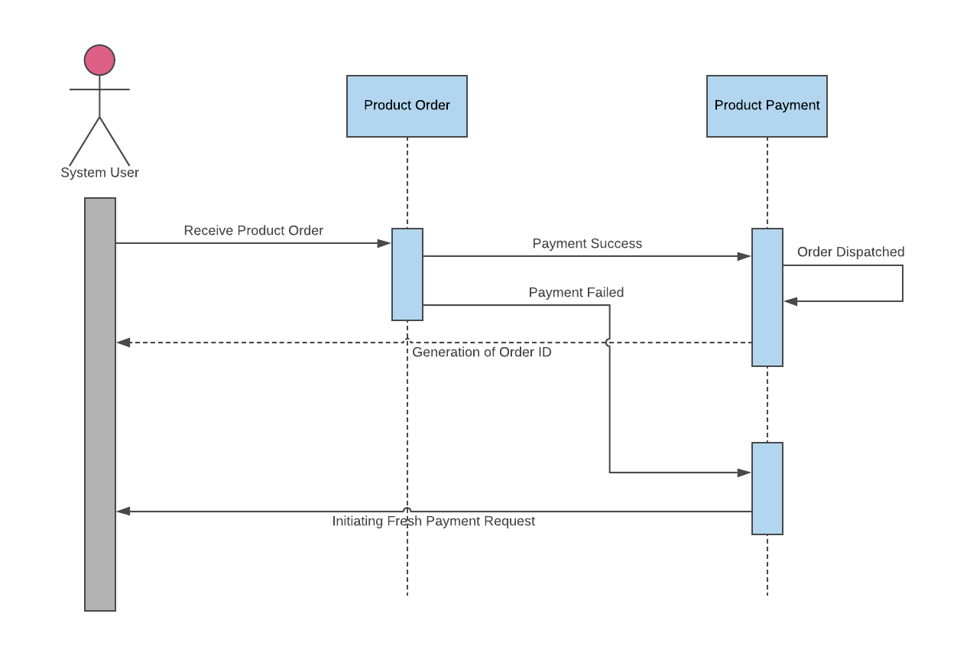
Sequence Diagram :
Distributor Payment Details

Slide 10
Thank You

